Slide 1
Module 9 Part 2
NoSQL Databases
Harvinder S Jabbal
SSZG653 Software Architectures

Slide 2
NoSQL databases
While Relational databases (SQL databases) are good for transaction management, not all applications need this feature.
Many web applications such as marketing applications, IoT applications, need fast processing of data but do not need transaction management
NoSQL databases came as a response to this need
https://www.dataversity.net/a-brief-history-of-non-relational-databases/#
November 4, 2023
SE ZG651/ SS ZG653 Software Architectures

Slide 3
NoSQL databases
Traditional databases also have limitations on storage
NoSQL databases are
  Scalable (Sharding)
  Fast (In Memory)
  Available (Replication)
  Handle semi-structured and unstructured data
  Rapidly adapt to changing data needs
However most lack
Transaction support (ACID)
Join feature
November 4, 2023
SE ZG651/ SS ZG653 Software Architectures

Slide 4
Examples of usage of NoSQL DB
Tesco, Europe’s #1 retailer, uses NoSQL to manage millions of products, promotions supply chain, etc.
Ryanair, the world’s busiest airline, uses NoSQL to power its mobile app serving over 3 million users
Marriott is deploying NoSQL for its reservation system that books $38 billion annually
Gannett (USA Today) the #1 U.S. newspaper publisher, uses NoSQL for its proprietary content management system, Presto
GE is deploying NoSQL for its Predix platform to help manage the Industrial Internet
November 4, 2023
SE ZG651/ SS ZG653 Software Architectures

Slide 5
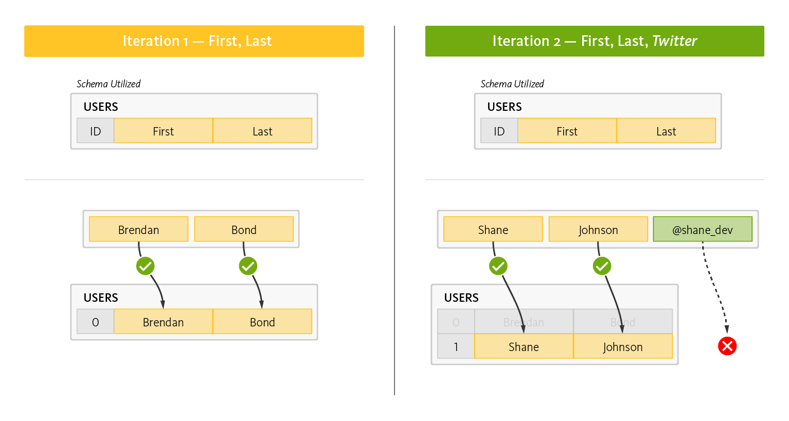
NoSQL - Flexibility
In RDBMS, if we want to add a new column, we need to change the schema
This can not be stored
Ref: https://www.couchbase.com/resources/why-nosql
November 4, 2023
SE ZG651/ SS ZG653 Software Architectures

Slide 6
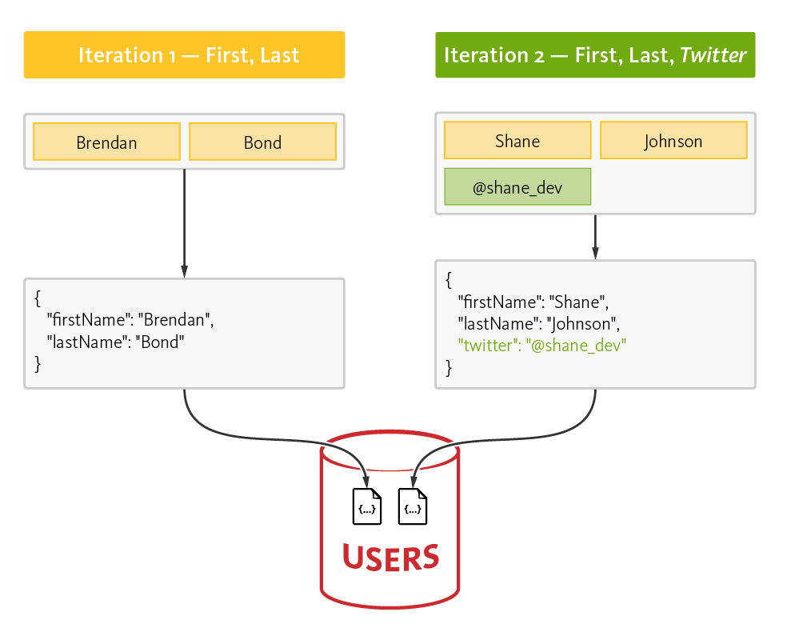
NoSQL - Flexibility
In NoSQL DB, we can easily add new columns.
Ref: https://www.couchbase.com/resources/why-nosql
November 4, 2023
SE ZG651/ SS ZG653 Software Architectures

Slide 7
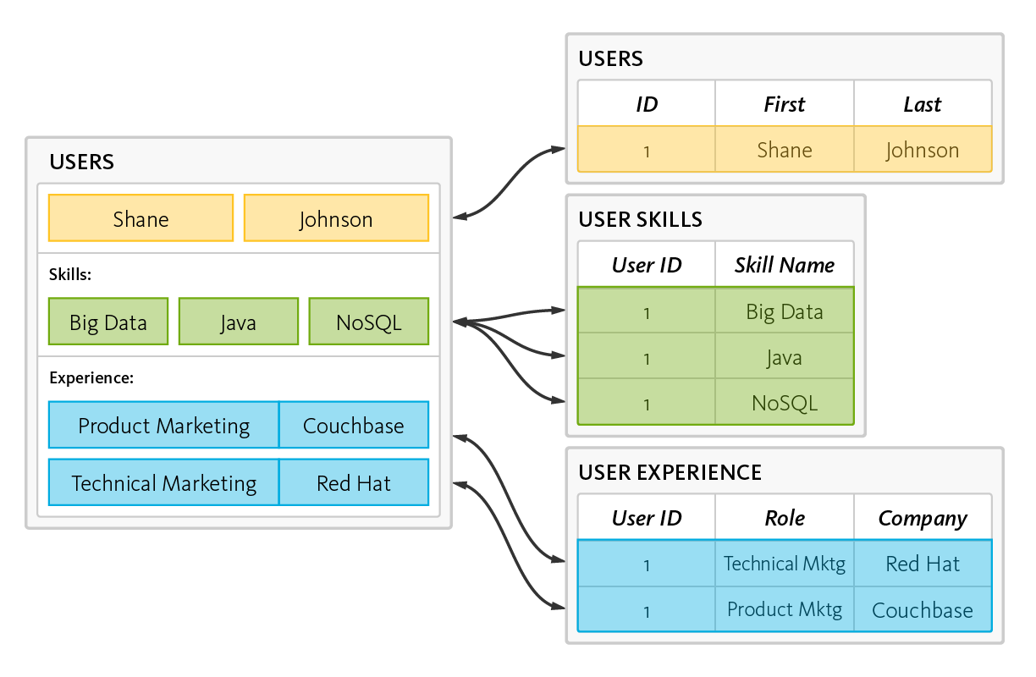
NoSQL - Simplicity
NoSQL
SQL
November 4, 2023
SE ZG651/ SS ZG653 Software Architectures

Slide 8
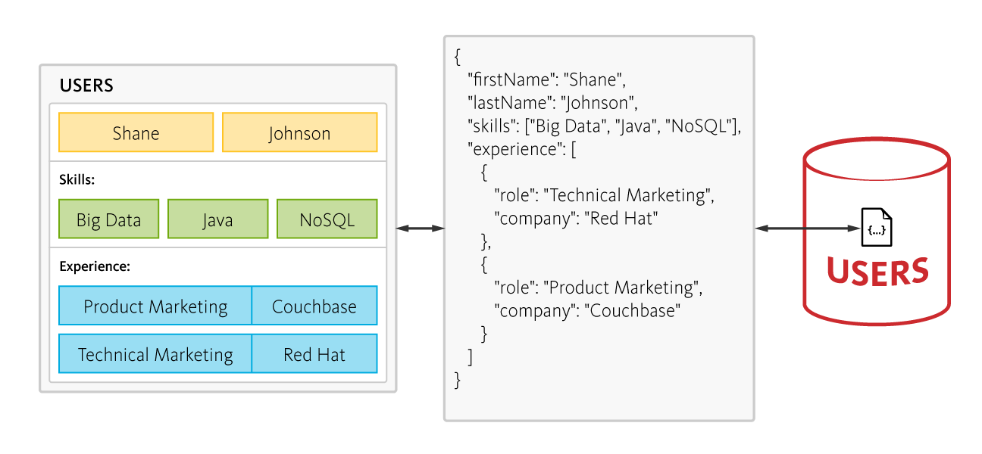
NoSQL - Simplicity
November 4, 2023
SE ZG651/ SS ZG653 Software Architectures

Slide 9
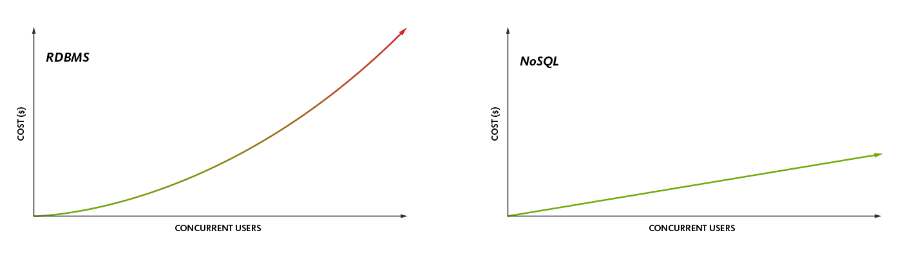
NoSQL – Cost effective
Cost: Memory, CPU, storage
November 4, 2023
SE ZG651/ SS ZG653 Software Architectures

Slide 10
NoSQL Database
Types of NoSQL databases:
  Document
  Key Value
  Column stores
  Graph
November 4, 2023
SE ZG651/ SS ZG653 Software Architectures

Slide 11
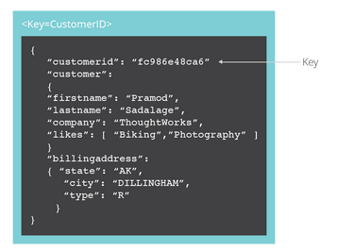
Document NoSQL database
The database stores and retrieves documents, which can be XML, JSON, BSON, and so on.
Some of the popular document databases we have seen are MongoDB, CouchDB , Terrastore, OrientDB, RavenDB, and of course the well-known and often reviled Lotus Notes that uses document storage.
Example of one record
November 4, 2023
SE ZG651/ SS ZG653 Software Architectures

Slide 12
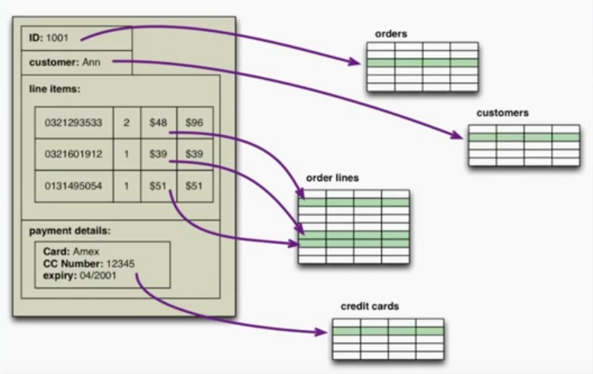
Document DB vs Relational DB
November 4, 2023
SE ZG651/ SS ZG653 Software Architectures

Slide 13
Good for
Ecommerce platform
Content management systems
November 4, 2023
SE ZG651/ SS ZG653 Software Architectures

Slide 14
Features of Mongo DB
Indexing
Ad hoc search
Replication
Partitioning / Sharding
  Ex. Partition data by Product or Geography
November 4, 2023
SE ZG651/ SS ZG653 Software Architectures

Slide 15
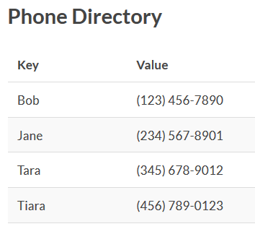
Key-Value database
Data model is Key value pair
Uses hashing for fast access
The DB does not care what is contained in the value
Example scenarios: Phone directory, Stock trading
Some of the popular key-value databases are Riak, Redis (often referred to as Data Structure server), Memcached and its flavors, Berkeley DB, upscaledb (especially suited for embedded use), Amazon DynamoDB (not open-source), Project Voldemort and Couchbase.
November 4, 2023
SE ZG651/ SS ZG653 Software Architectures

Slide 16
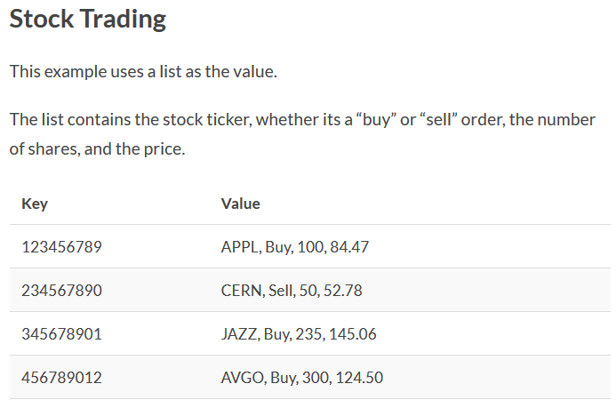
Example of key value database
More examples: User profiles, Blog comments
November 4, 2023
SE ZG651/ SS ZG653 Software Architectures

Slide 17
Uses of Redis
Session cache, with persistence
November 4, 2023
SE ZG651/ SS ZG653 Software Architectures

Slide 18
Column oriented database
This is useful for data analysis scenarios
Example: Calculate the average usage of electricity in 2018 in East Bangalore region
Traditional way: Read all the billing records of 2018
Cust id, Name, Addrs, Region, Month, Year, Usage, Amt,
Record 1: 001, John Mancha, Addr 1, East, Jan, 2018, 100, 600
Record 2: 002, Vivek Kulkarni, Addr 2, East, Jan, 2018, 90, 540
Record 3: 003, Shanti Sharma, Addr 3, West, Jan, 2018, 110, 660
….
….
November 4, 2023
SE ZG651/ SS ZG653 Software Architectures

Slide 19
Column oriented database
Instead if we store the data as follows:
Record 1: 001, John Mancha, Addr 1, East // Customer details
Record 2: 002, Vivek Kulkarni, Addr 2, East
Record A: Jan, 2018, 100, 90, 110, … // Usage – in customer order
Record B: Feb, 2018, 110, 92, 115, …
Only one record ‘Record A’ is needed to calculate average usage in Jan 2018
Good for summarization
November 4, 2023
SE ZG651/ SS ZG653 Software Architectures

Slide 20
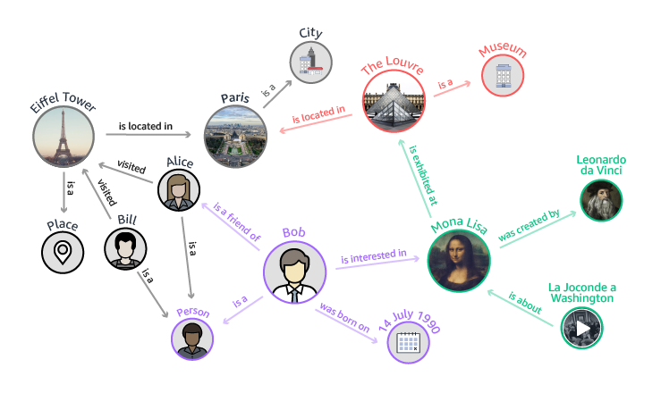
Graph database: Example: Knowledge graph
Entities and their relationships
November 4, 2023
SE ZG651/ SS ZG653 Software Architectures

Slide 21
Graph database
Entities and relationships have properties (attributes)
Ex.
  Eifel tower properties can be height, date of construction
  Visited relationship can have properties such as date of visit
Uses
Store a large amount of inter-related information and to search for an entity along with its relationships
Fraud detection
Social networks
Source: https://opensourceforu.com/2017/05/different-types-nosql-databases/
November 4, 2023
SE ZG651/ SS ZG653 Software Architectures

Slide 22
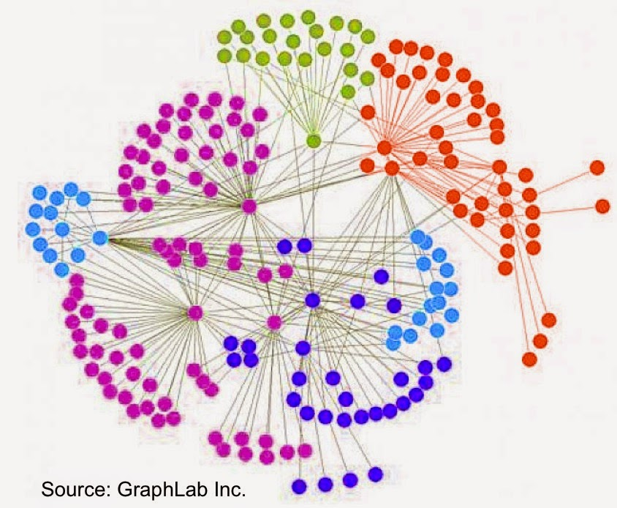
Can be use to detect hidden patterns
Easy to understand clusters
November 4, 2023
SE ZG651/ SS ZG653 Software Architectures

Slide 23
Graph database
Graph databases allow you to store entities and relationships between these entities.
Entities are also known as nodes, which have properties. Think of a node as an instance of an object in the application.
Relations are known as edges that can have properties. Edges have directional significance; nodes are organized by relationships which allow you to find interesting patterns between the nodes.
There are many graph databases available, such as Neo4J, Infinite Graph, OrientDB, or FlockDB
November 4, 2023
SE ZG651/ SS ZG653 Software Architectures

Slide 24
In-Memory databases
An in-memory database (IMDB; also main memory database system or MMDB or memory resident database) is a database management system that primarily relies on main memory
Applications where response time is critical, such as those running telecommunications network equipment and mobile advertising networks, often use main-memory databases
With the introduction of non-volatile random access memory technology (Flash memory), in-memory databases will be able to run at full speed and maintain data in the event of power failure
Popular In-memory databases are SAP’s HANA, IBM DB2 BLU, Oracle
These databases support OLTP and OLAP (Online Analytical Processing)
November 4, 2023
SE ZG651/ SS ZG653 Software Architectures

Slide 25
Acknowledgement
Sources
Hadoop
https://www.mssqltips.com/sqlserverauthor/77/dattatrey-sindol/
NoSQL Database
https://www.thoughtworks.com/insights/blog/nosql-databases-overview
November 4, 2023
SE ZG651/ SS ZG653 Software Architectures

Slide 26
Appendix
November 4, 2023
SE ZG651/ SS ZG653 Software Architectures

Slide 27
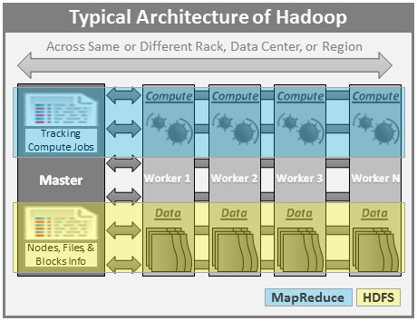
November 4, 2023
SE ZG651/ SS ZG653 Software Architectures

Slide 28
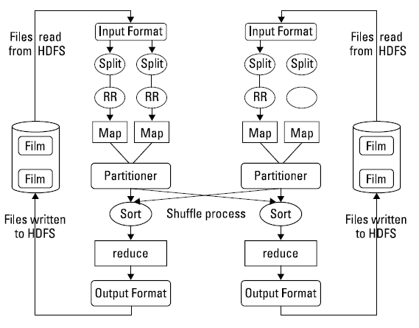
November 4, 2023
SE ZG651/ SS ZG653 Software Architectures

Slide 29
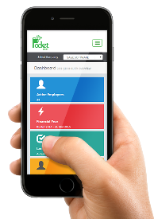
Example of Stream processing in a cab hailing company like Ola / Uber
Pickup event
Msg. to Ops team
Driver app
Analyse delay
Driver event handler
API
Msg. to Ops team &
Customer
Cab location event
Analyse deviation
Send
SMS
SMS Msg Q
Customer app
Customer event handler
Emergency event
API
Alert Ops team
Msg. to Ops team
November 4, 2023
SE ZG651/ SS ZG653 Software Architectures

Slide 30
Analytics
Data Visualization
Multi-dimensional data
Data mining
Examples…
Tools ….
November 4, 2023
SE ZG651/ SS ZG653 Software Architectures

Slide 31
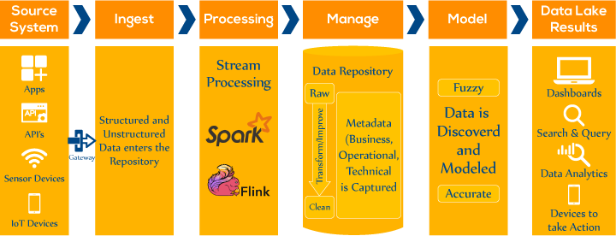
Real-Time Streaming and Data Analytics For IoT
Source: https://www.xenonstack.com/blog/big-data-engineering/real-time-streaming-analytics-tools/
November 4, 2023
SE ZG651/ SS ZG653 Software Architectures

Slide 32
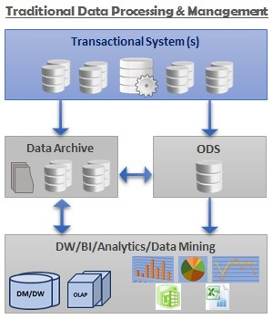
Traditional Data Processing
ODS: Operational Data Store
November 4, 2023
SE ZG651/ SS ZG653 Software Architectures

Slide 33
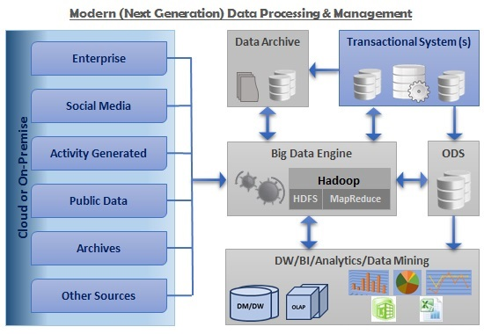
November 4, 2023
SE ZG651/ SS ZG653 Software Architectures

Slide 34
Use cases of Stream Processing
Following are some of the use cases.
Algorithmic Trading, Stock Market Surveillance,
Smart Patient Care
Monitoring a production line
Supply chain optimizations
Intrusion, Surveillance and Fraud Detection ( e.g. Uber)
Most Smart Device Applications : Smart Car, Smart Home ..
Smart Grid — (e.g. load prediction and outlier plug detection see Smart grids, 4 Billion events, throughout in range of 100Ks)
Traffic Monitoring, Geo fencing, Vehicle and Wildlife tracking — e.g. TFL London Transport Management System
Sport analytics — Augment Sports with realtime analytics (e.g. this is a work we did with a real football game (e.g. Overlaying realtime analytics on Football Broadcasts)
Context-aware promotions and advertising
Computer system and network monitoring
Predictive Maintenance, (e.g. Machine Learning Techniques for Predictive Maintenance)
Geospatial data processing
November 4, 2023
SE ZG651/ SS ZG653 Software Architectures

Slide 35
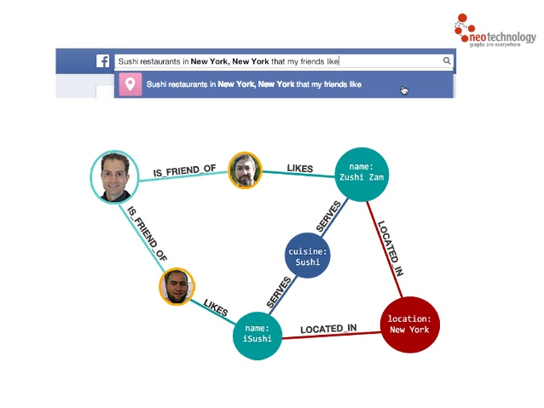
November 4, 2023
SE ZG651/ SS ZG653 Software Architectures

Slide 36
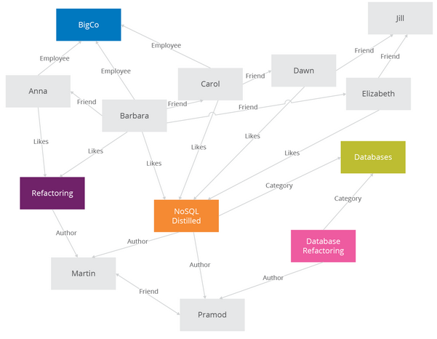
Graph database
November 4, 2023
SE ZG651/ SS ZG653 Software Architectures

Slide 37
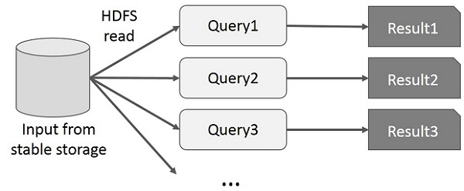
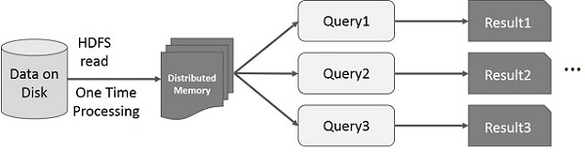
Difference between Hadoop & Spark…
Interactive operation using Hadoop
Interactive operation using Spark
Source: https://www.tutorialspoint.com/apache_spark/apache_spark_rdd.htm
November 4, 2023
SE ZG651/ SS ZG653 Software Architectures

Slide 38
Real-time analytics
Detecting bank fraud requires real-time analytics as events happen
Such situations demand processing of each event as they happen rather processing a batch of data on disk
This led to tools such as Spark Streams and Storm which support in-memory processing, than disk based processing
November 4, 2023
SE ZG651/ SS ZG653 Software Architectures

Slide 39
Storm for real time computing
Apache Storm is a free and open source distributed real time computation system. Storm makes it easy to reliably process unbounded streams of data, doing for realtime processing what Hadoop did for batch processing. Storm is simple, can be used with any programming language, and is a lot of fun to use!
Storm has many use cases: real time analytics, online machine learning, continuous computation, distributed RPC, ETL, and more. Storm is fast: a benchmark clocked it at over a million tuples processed per second per node. It is scalable, fault-tolerant, guarantees your data will be processed, and is easy to set up and operate.
Storm integrates with the queueing and database technologies you already use. A Storm topology consumes streams of data and processes those streams in arbitrarily complex ways, repartitioning the streams between each stage of the computation however needed. Read more in the tutorial.
Source: http://storm.apache.org/
November 4, 2023
SE ZG651/ SS ZG653 Software Architectures

Slide 40
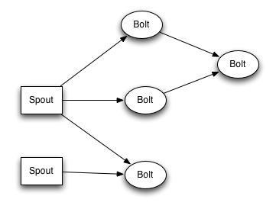
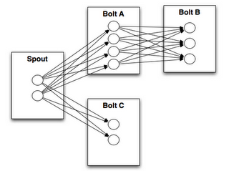
Storm topology
Twitter uses Storm for real-time analytics, personalization, search, revenue optimization
Groupon uses Storm for Real-time data integration systems
Yahoo! Uses Storm for processing user events, content feeds, and application logs.
November 4, 2023
SE ZG651/ SS ZG653 Software Architectures

Slide 41
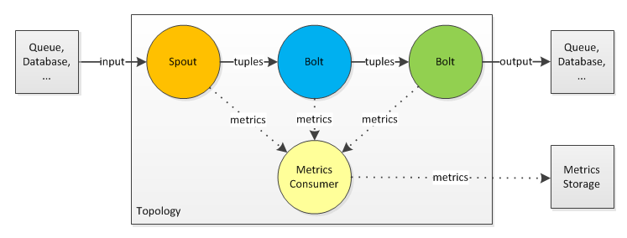
Architecture of Storm system
November 4, 2023
SE ZG651/ SS ZG653 Software Architectures

Slide 42
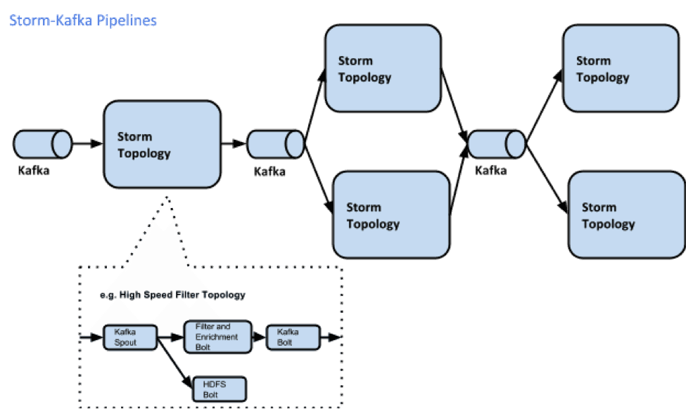
Combining Kafka and Storm for real time computing
Kafka is a distributed and robust queue that can handle high volume data and enables you to pass messages from one end-point to another (Publish - Subscribe)
November 4, 2023
SE ZG651/ SS ZG653 Software Architectures
Source: https://hortonworks.com/blog/storm-kafka-together-real-time-data-refinery/

Slide 43
Storm & Kafka
The common flow of these tools (as I know it) goes as follows:
real-time-system --> Kafka --> Storm --> NoSql --> BI(optional)
November 4, 2023
SE ZG651/ SS ZG653 Software Architectures

Slide 44
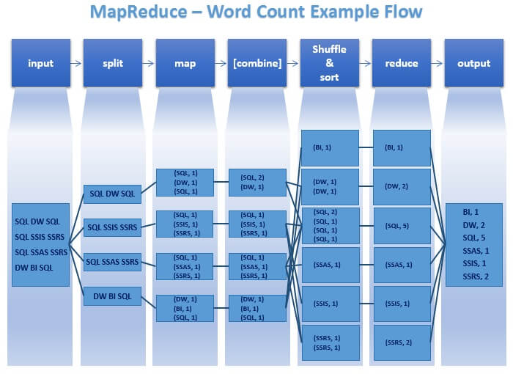
November 4, 2023
SE ZG651/ SS ZG653 Software Architectures

